Slide 1
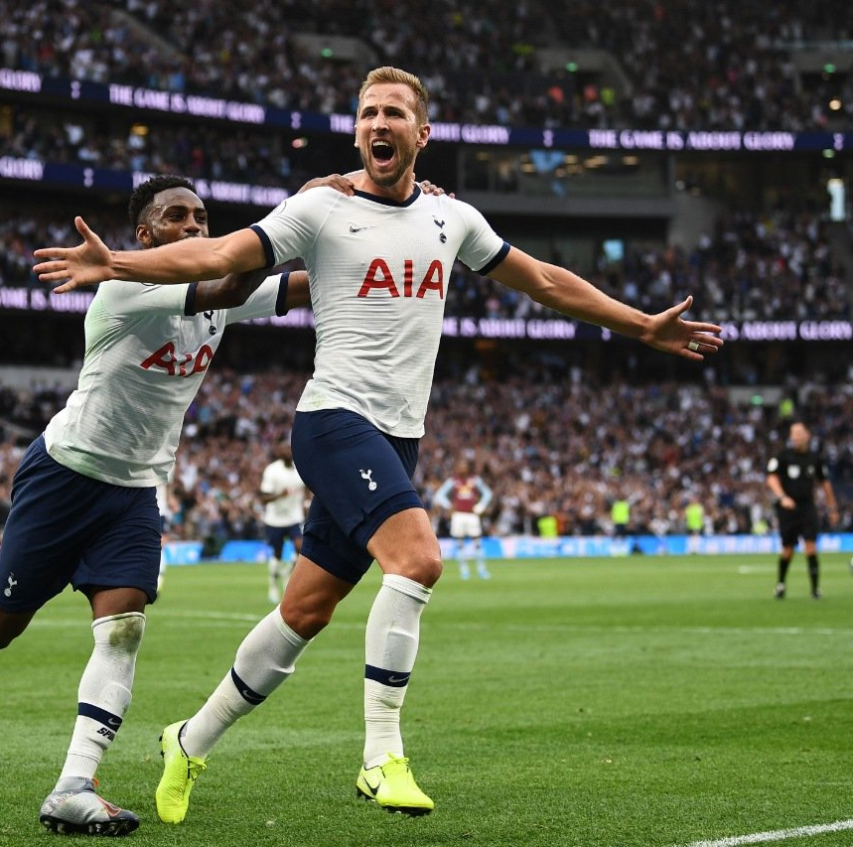
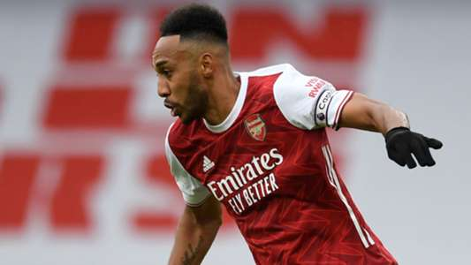

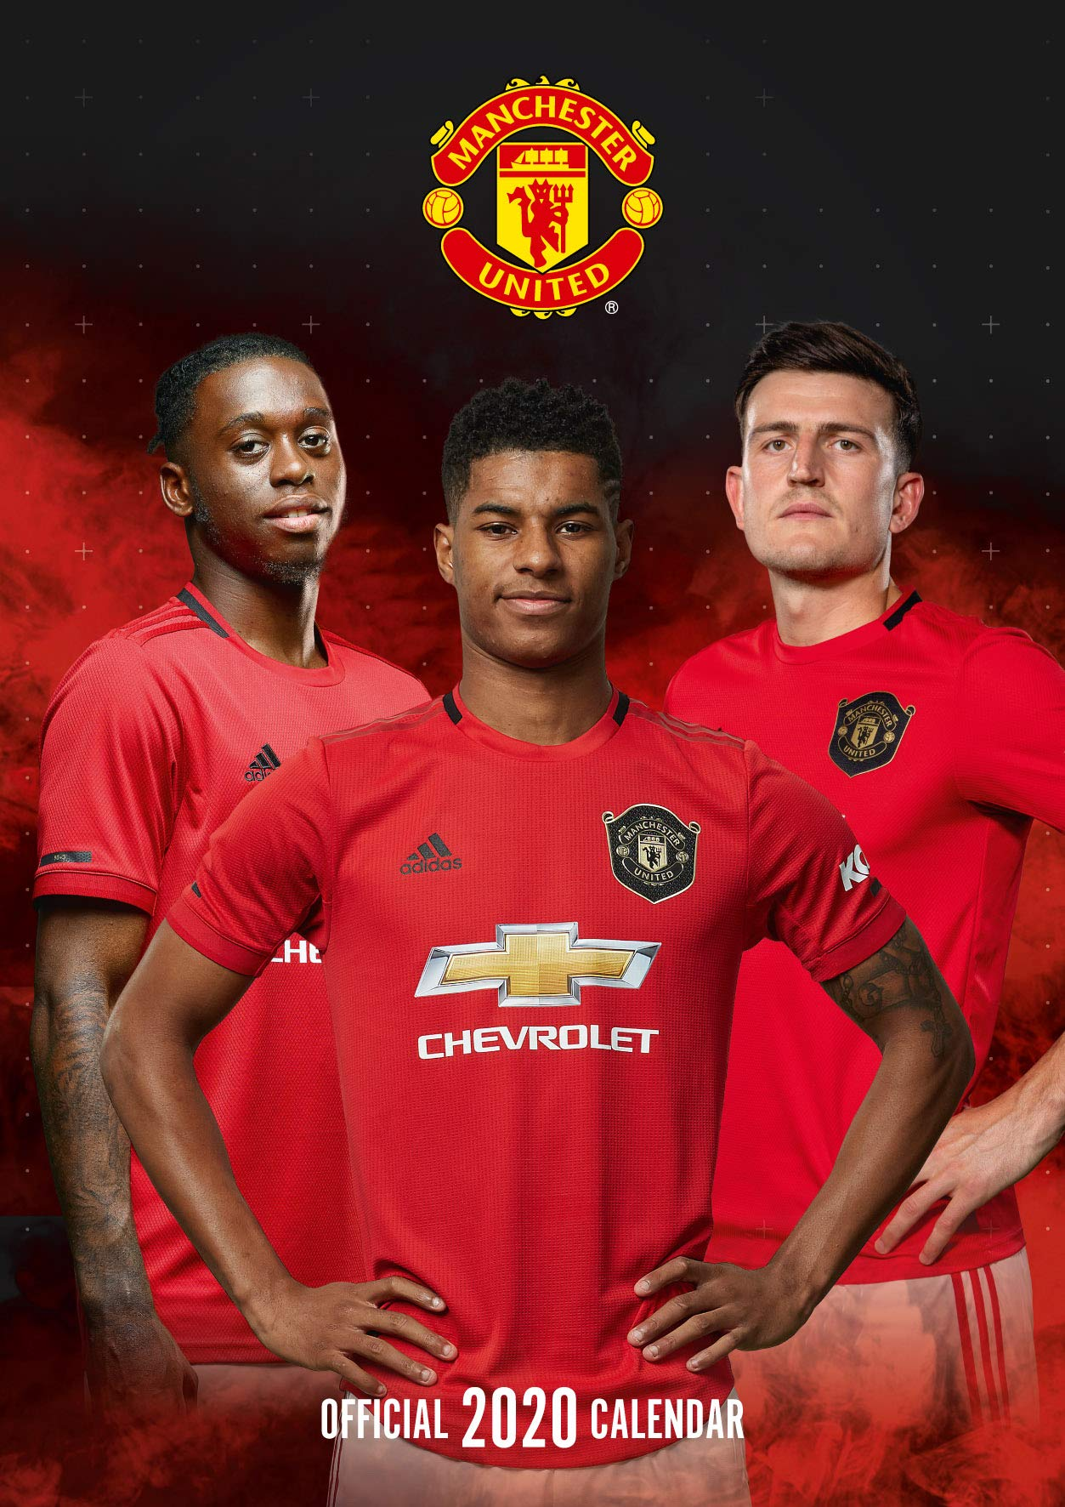
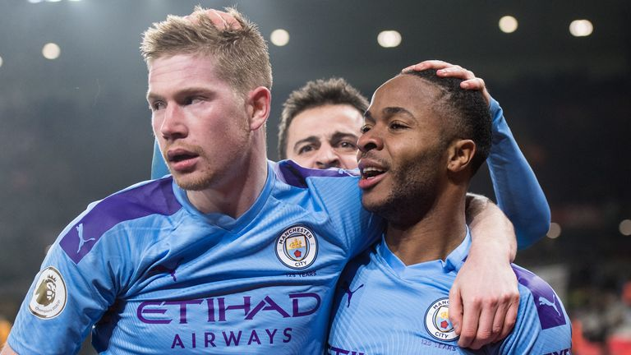
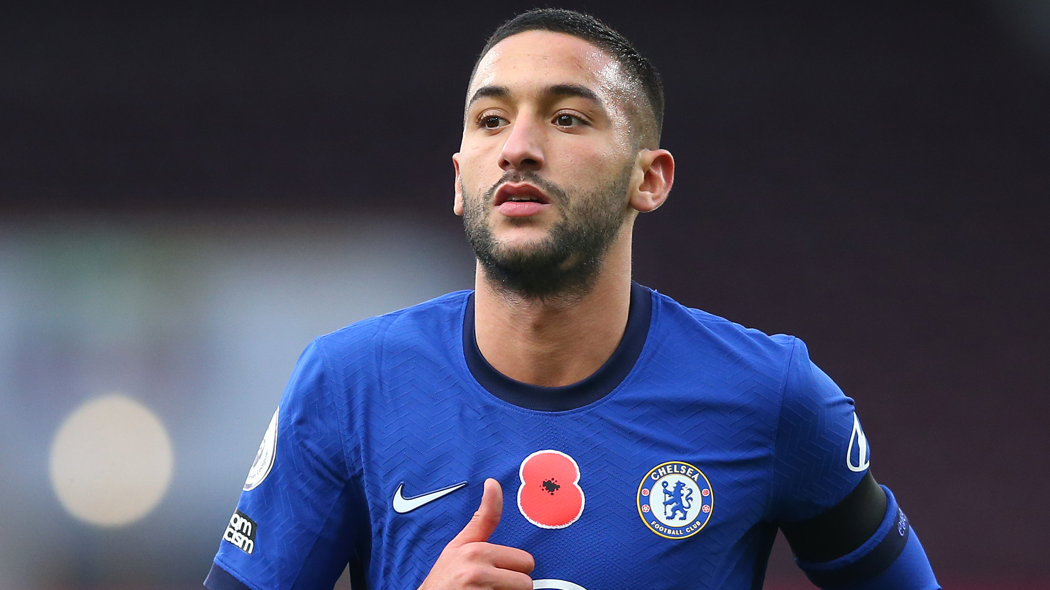
English
Predicting the winner of an EPL season!
By Ashish

Slide 2
BACKGROUND
History of EPL
Radically restructured in the early 1990s.
Commercially independent of the FA (Football Association).
Top level of the English football league system.
Contested by 20 teams.
Bottom 3 teams get relegated to the lower division each season.
Sports Betting
Sports betting is the activity of predicting sports results and placing a wager on the outcome.
Heavy importance placed on not just predicting the winner of each game, but also the entire season.

Slide 3
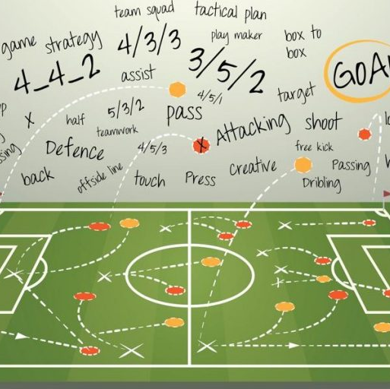
INTRODUCTION
Prediction:
Initial Objective: Determine the winner of the 2020-2021 EPL season.
Revised Objective: Determine the winner of the 2015-2016 EPL season.
Data ranging from 2009 to 2015.
Contains goals scored for each match played between 2 teams.
Contains season-level team attributes describing the style of play (defensive, aggressive, high-press, etc) of each team.

Slide 4
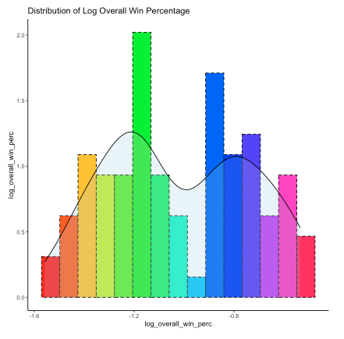
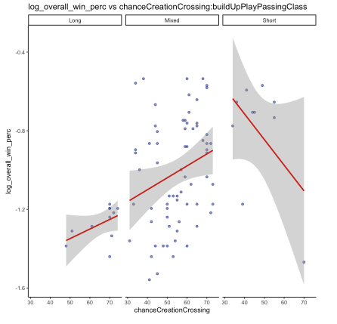
Exploratory Data Analysis
Observed two peaks after transformations
Overall win percentage increases when having long & mixed build up passing. Decreases when build up play is short with respect to number of crosses.

Slide 5
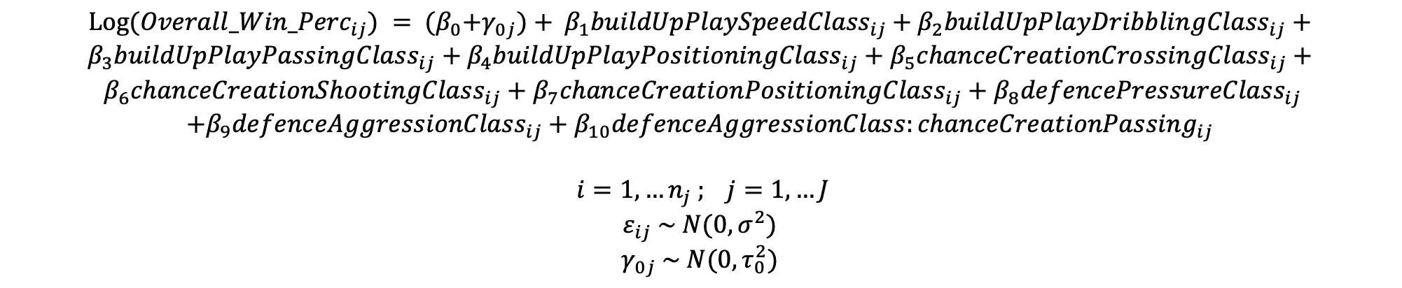
Model selection
Null Model
Full Model
Anova Test
Multi-collinearity
Model Assumptions
Final Model
$Log({Overall_Win_Perc}_{ij}) = {{(β}_{0}+γ_{0j})+ β}_{1}{buildUpPlaySpeedClass}_{ij}$ $+$ $β_{2}{buildUpPlayDribblingClass}_{ij}+β_{3}{buildUpPlayPassingClass}_{ij}+$ $β_{4}{buildUpPlayPositioningClass}_{ij}+$ $β_{5}{chanceCreationCrossingClass}_{ij}+$
$β_{6}{chanceCreationShootingClass}_{ij}+β_{7}{chanceCreationPositioningClass}_{ij}+β_{8}{defencePressureClass}_{ij}$
$$+β_{9}{defenceAggressionClass}_{ij}+β_{10}{defenceAggressionClass:chanceCreationPassing}_{ij}$$
$$i=1,…n_{j} ; j=1, …J$$
$$ε_{ij} \sim N(0,σ^{2})$$
$$γ_{0j} \sim N(0,τ_{0}^{2})$$

Slide 6
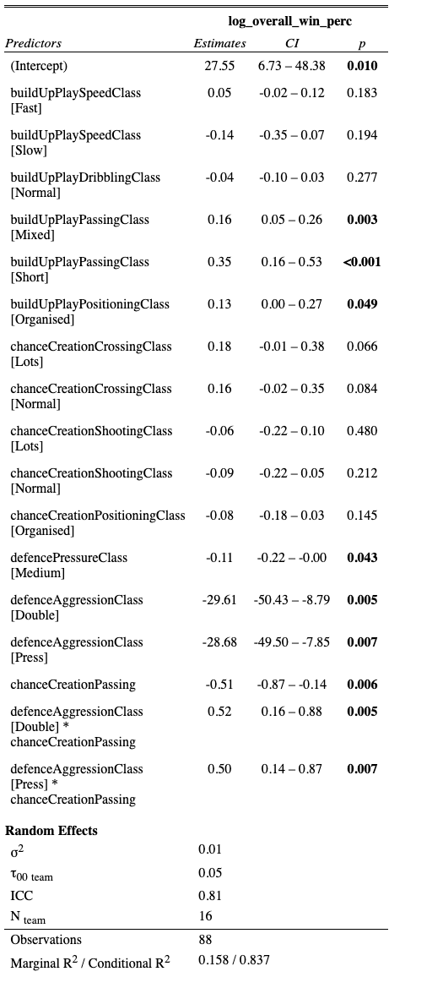
Model Summary

Slide 7
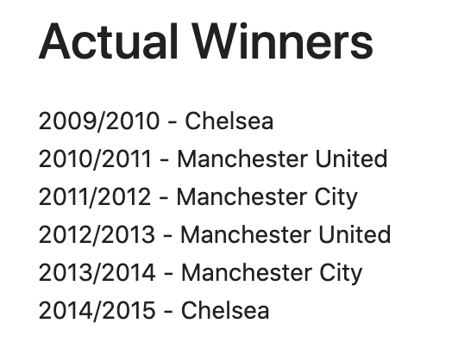
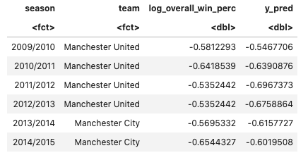
In-sample model validation

Slide 8
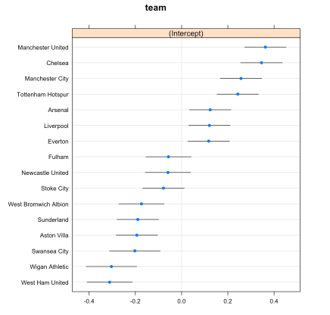
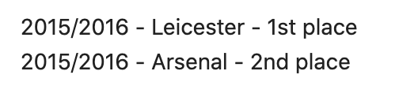
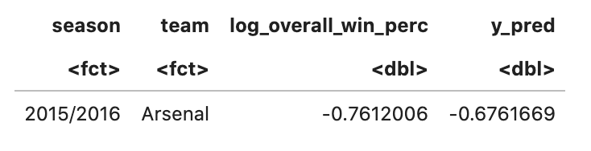
Out of sample PREDICTION
Actual Winner of 2015/2016 EPL Season
Predicted Winner of 2015/2016 EPL Season

Slide 9

limitations
Data ranging from just 2009 to 2015 is insufficient to make reliable predictions.
Need to explore player level attributes & per match level team performance characteristics.

Slide 10
Thank you!

